Slide 1
Java FileOutputStream class
myfile.txt
Write
Java Application
010101011011
010101011011
A file output stream is an output stream for writing data to a File or to a FileDescriptor. Whether or not a file is available or may be created depends upon the underlying platform. Some platforms, in particular, allow a file to be opened for writing by only one FileOutputStream (or other file-writing object) at a time. In such situations the constructors in this class will fail if the file involved is already open.
FileOutputStream is meant for writing streams of raw bytes such as image data. For writing streams of characters, consider using FileWriter.

Slide 2
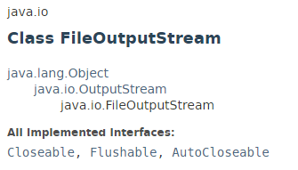
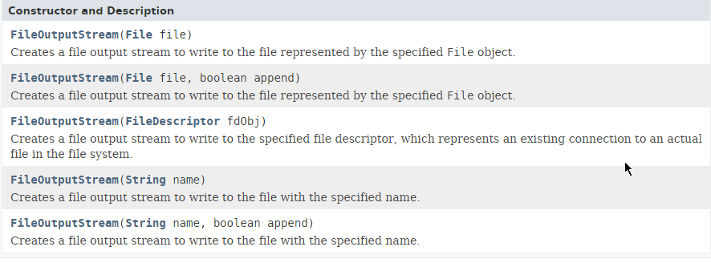
Java FileOutputStream class

Slide 3
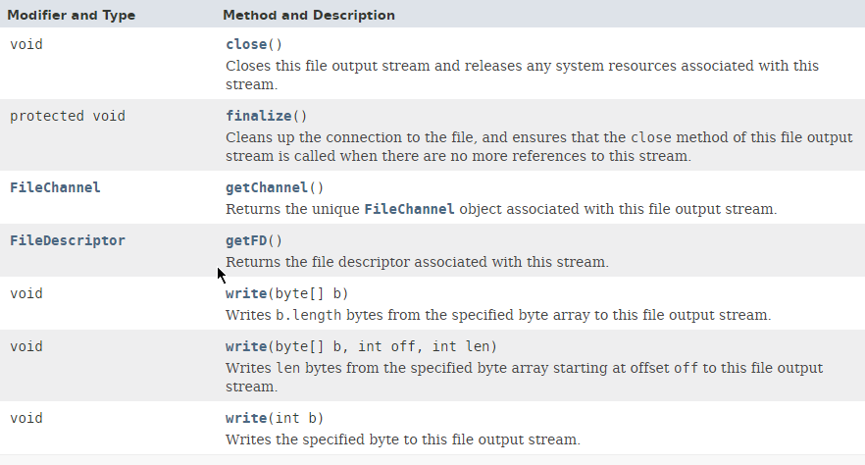
Java FileOutputStream class

Slide 4
Java FileOutputStream class
https://docs.oracle.com/javase/8/docs/api/java/io/FileOutputStream.html

